Slide 1



Machine Learning [Feature Engineering]
exploration into the world of machine learning

Slide 2


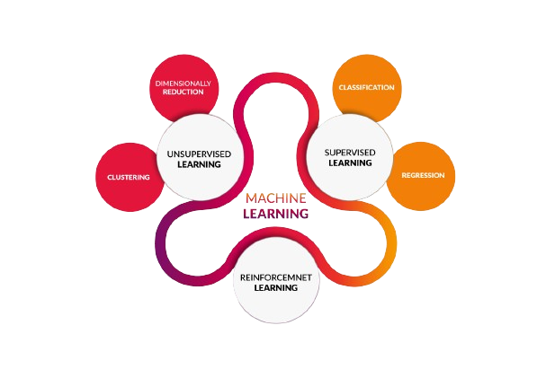
History Of Machine Learning
( A journey through the Time Line )
Definition :- Machine Learning is a subset of Artificial Intelligence that focuses on developing algorithms and models that enable computers to learn from data and make intelligent decisions without being explicitly programmed.
The term “Machine Learning" was coined by Arthur Samuel. Arthur Samuel was an American computer scientist and a pioneer in the field of artificial intelligence.
Kasparov's defeat sparked discussions about the capabilities of machines versus human intelligence and the potential of AI in various domains.
Deep Blue could analyze up to 200 million positions per second during the match, allowing it to explore a wide range of potential moves and counter-moves.

Slide 3

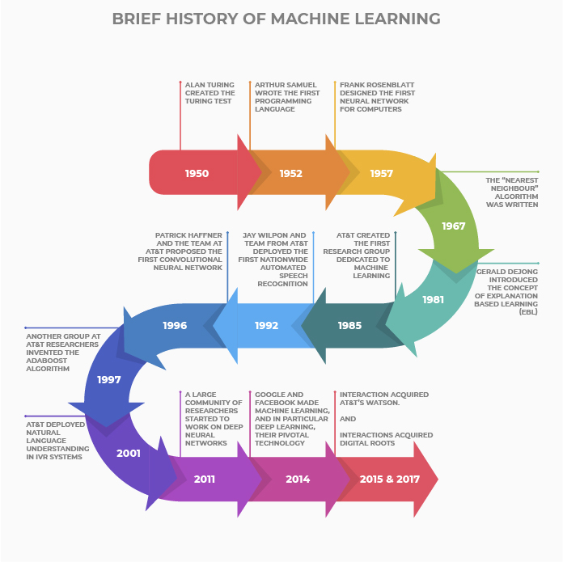

Slide 4
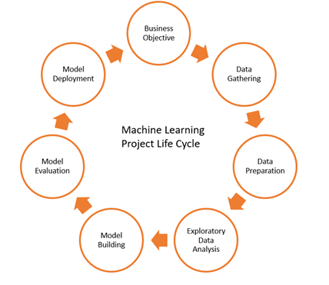
ML Life Cycle
Data preparation :- is a critical step in the Model Development workflow, involving the cleaning, transforming, and organizing of raw data into a format suitable for analysis or model training.
>> Here are some key data preparation techniques:
Data Cleaning:
Handling Missing Values
Outlier Detection and Handling
Feature Engineering:
Feature Construction
Feature Encoding
Feature Scaling
Feature Transformation
Feature Extraction

Slide 5
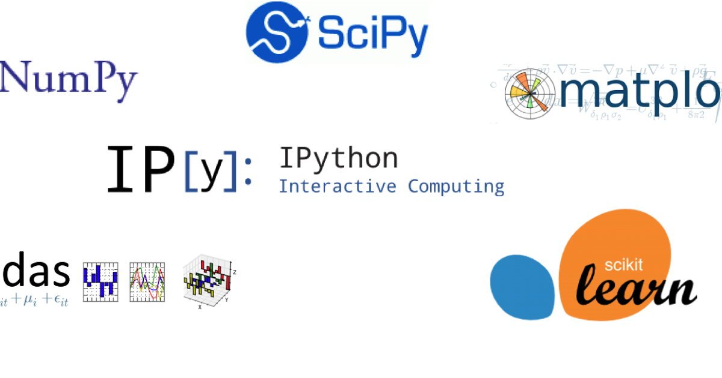

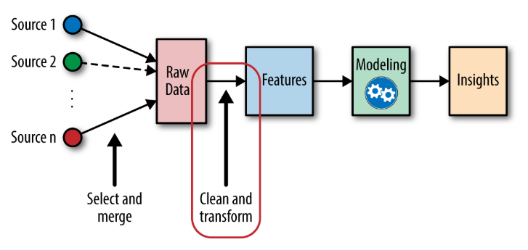
EDA :- is the initial phase of data analysis where you explore and understand the structure, patterns, and characteristics of your dataset. It involves tasks such as summary statistics, visualizations, and identifying patterns or outliers in the data.
Feature Engineering :- Once you have insights from EDA, you move on to feature engineering. It involves transforming raw data into a format that enhances the performance of machine learning models.
You create new features, handle missing data, encode variables, and more, based on what you discovered during EDA

Slide 6
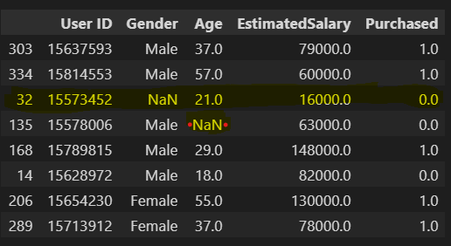
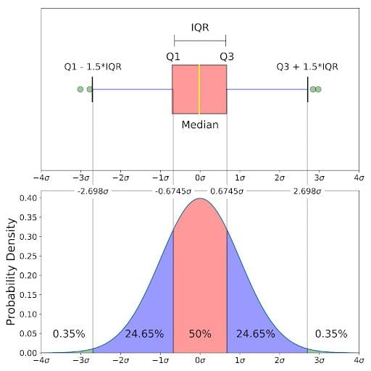
Data Cleaning: → Handling Missing Values * Pandas * Scikit-Learn → Outlier Detection and Handling * Boxplot >> IQR(Inter Quartile Range) * (Q1) → 25 percentile * (Q2) → 50 Percentile *(Q3) → 75 percentile * IQR = Q3 – Q1

Slide 7
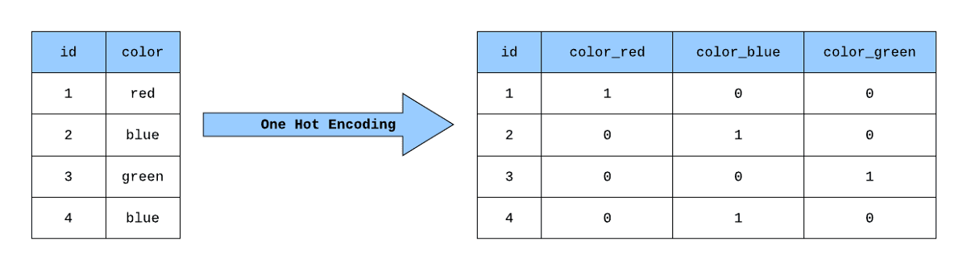
Feature Construction (:- -> Feature engineering is a process in which we create new features from the existing features in our data set. The new features are often more relevant to the prediction task than the original set of features, and thus can help the machine learning model achieve better results.
---> Sometimes the new features are created by applying simple arithmetic operations, such as calculating ratios or sums from the original features. In other cases, more specific domain-knowledge on the data set is required in order to come up with good indicative features.
Feature Encoding (:- ->
Nominal Encoding : ->
Nominal encoding is used for categorical features without any inherent order or ranking. One common method is one-hot encoding. In this technique, each category is assigned a binary value (0 or 1), creating a new binary column for each category. This way, the model understands the presence or absence of a category.

Slide 8
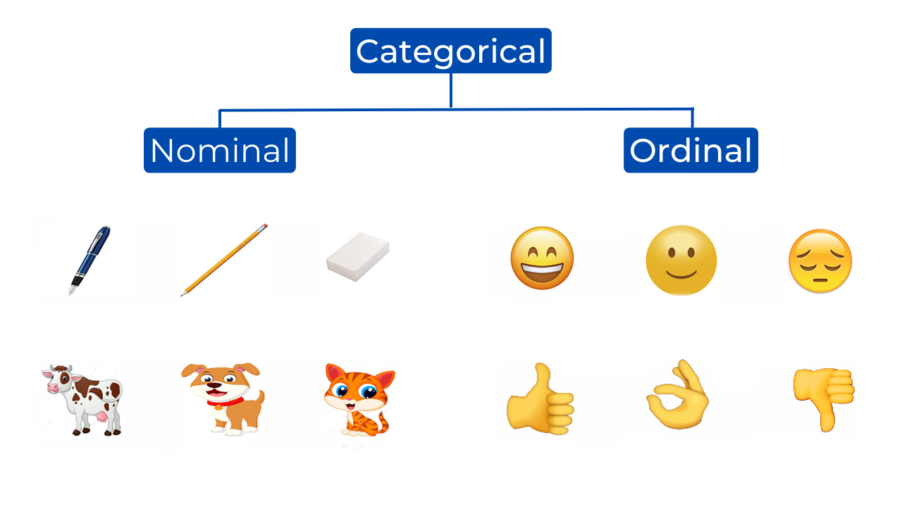
Ordinal Encoding: - Ordinal encoding is applied to categorical features with a clear order or ranking among the categories. Each category is assigned a numerical value based on its position in the order. This helps the model understand the hierarchy among the categories.
Label Encoding : - label encoding is a technique that is used to convert categorical columns into numerical ones so that they can be fitted by machine learning models which only take numerical data. It is an important pre-processing step in a ML project.
Feature Scaling (:- ->
Feature scaling is a preprocessing step that standardizes the range of independent variables or features of the data. It's important because many machine learning algorithms are sensitive to the scale of the input features. Scaling ensures that all features contribute equally to the model's performance.

Slide 9
Standard Scaler : - -> ** Mean (0) ** Stdandard Deviation (1)
Min Max Scaler : - -> ** Min(0) ** Maximum(1)

Slide 10


Check out these ML journey Boosters …… ☺
Feature Construction Techniques
Feature Encoding Techniques
Nominal / Ordinal Encoding Techniques
Feature Scaling Techniques

